Slide 1
SQLite database
Embeds the SQLite database engine in R, providing a DBI-compliant interface. SQLite is a public-domain, single-user, very light-weight database engine that implements a decent subset of the SQL 92 standard, including the core table creation, updating, insertion, and selection operations, plus transaction management.

Slide 2
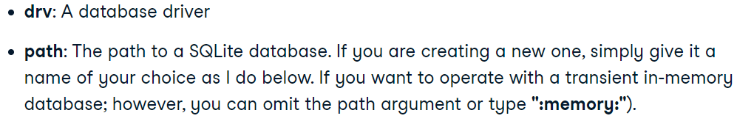

Slide 3
Creating Databases and Tables
RSQLite is the easiest way to use a database from R because the package itself contains SQLite; no external software is needed.

Slide 4
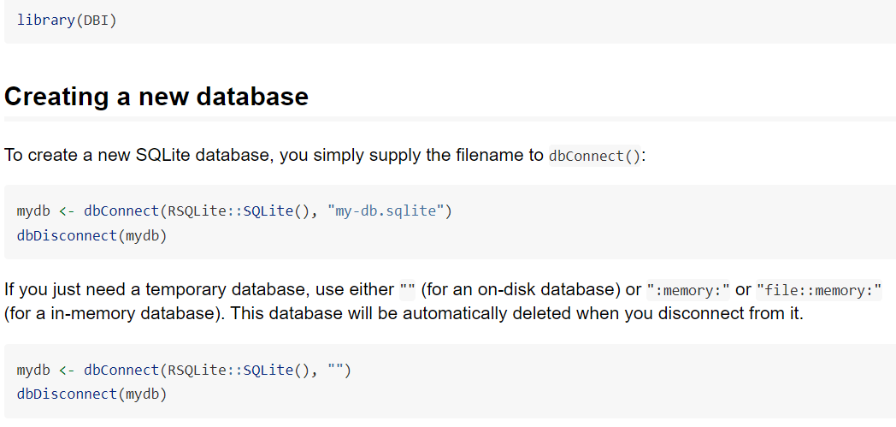

Slide 5
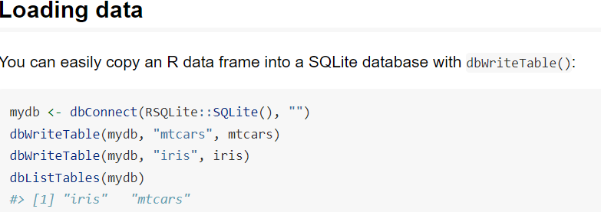

Slide 6
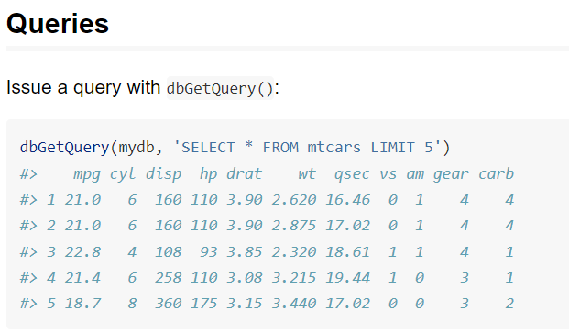

Slide 7
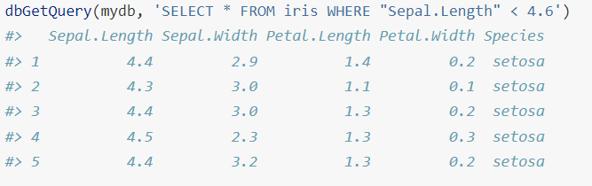

Slide 8
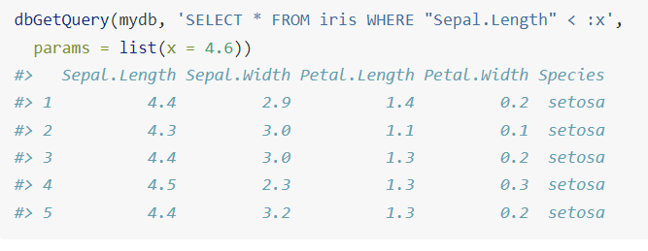

Slide 9
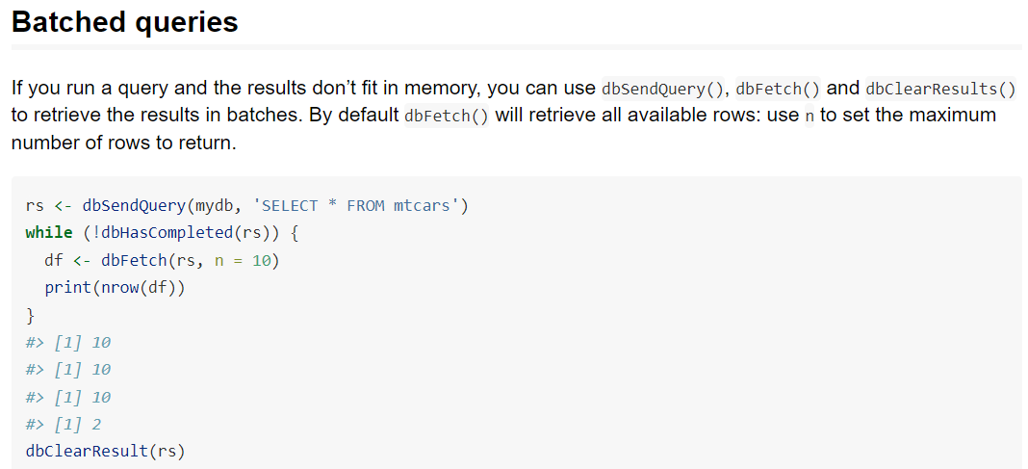

Slide 10
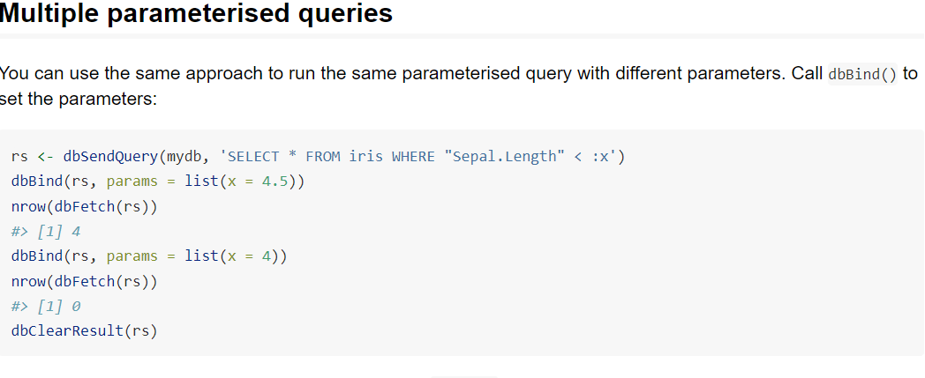

Slide 11
